Slide 1
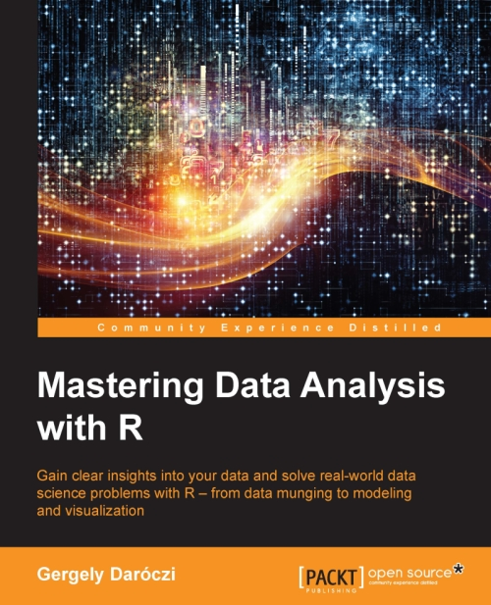

Slide 2
Objects
An object is a data structure having some attributes.
Creation
Basic or “atomic” classes of objects
Types of objects
Summary of types of objects
Missing values
Attributes

Slide 3
Objects
Creation
- Assign a value
- Create a blank object

Slide 4
Entering Input
Creation
Assign a value
At the R prompt we type expressions. The <- symbol is the assignment operator.
> x <- 1
> print(x)
[1] 1
> x
[1] 1
> msg <- "hello"
The grammar of the language determines whether an expression is complete or not.
> x <- ## Incomplete expression
The # character indicates a comment. Anything to the right of the # (including the # itself) is ignored.

Slide 5
Evaluation
When a complete expression is entered at the prompt, it is evaluated and the result of the evaluated expression is returned. The result may be auto-printed.
> x <- 5
> x
[1] 5
> print(x)
[1] 5
## nothing printed
## auto-printing occurs
## explicit printing
The [1] indicates that x is a vector and 5 is the first element.

Slide 6
Printing
The : operator is used to create integer sequences.
> x <- 1:20
> x
[1] 1 2 3 4 5 6 7 8 9 10 11 12 13 14 15
[16] 16 17 18 19 20

Slide 7
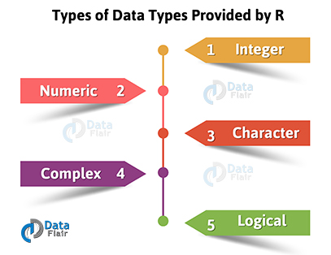
Basic or Atomic Classes of Objects

Slide 8
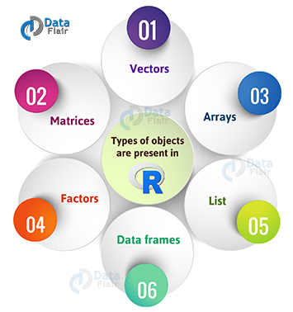

Slide 9
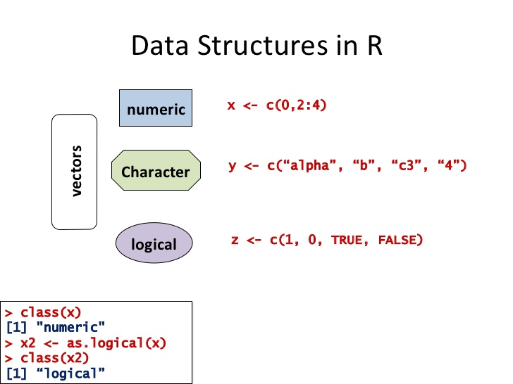
Creating Vectors
The c() function can be used to create vectors of objects.
> x <- c(0.5, 0.6) ## numeric
> x <- c(TRUE, FALSE) ## logical
> x <- c(T, F) ## logical
> x <- c("a", "b", "c") ## character
> x <- 9:29 ## integer
> x <- c(1+0i, 2+4i) ## complex
Using the vector() function
> x <- vector("numeric", length = 10)
> x
[1] 0 0 0 0 0 0 0 0 0 0

Slide 10


Slide 11
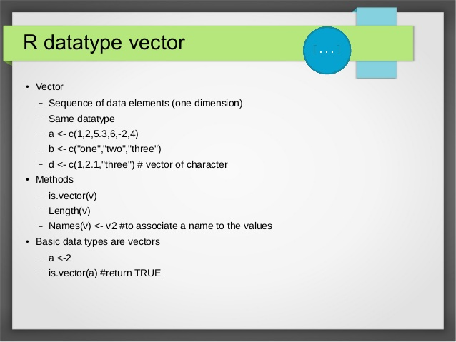

Slide 12
Names
R objects can have names, which is very useful for writing readable code and self-describing objects.
Here is an example of assigning names to an integer vector.
> x <- 1:3
> names(x)
NULL
> names(x) <- c("New York", "Seattle", "Los Angeles")
> x
New York Seattle Los Angeles
1 2 3
> names(x)
[1] "New York" "Seattle" "Los Angeles"
Lists can also have names, which is often very useful.
> x <- list("Los Angeles" = 1, Boston = 2, London = 3)
> x

Slide 13
Mixing Objects
What about the following?
> y <- c(1.7, "a") ## character
> y <- c(TRUE, 2) ## numeric
> y <- c("a", TRUE) ## character
When different objects are mixed in a vector, coercion occurs so that every element in the vector is of the same class.

Slide 14
Explicit Coercion
Objects can be explicitly coerced from one class to another using the as.* functions, if available.
> x <- 0:6
> class(x)
[1] "integer"
> as.numeric(x) [1] 0 1 2 3 4 5 6
> as.logical(x)
[1] FALSE TRUE TRUE TRUE TRUE TRUE TRUE
> as.character(x)
[1] "0" "1" "2" "3" "4" "5" "6"

Slide 15
Explicit Coercion
Nonsensical coercion results in NAs.
> x <- c("a", "b", "c")
> as.numeric(x)
[1] NA NA NA Warning message:
NAs introduced by coercion
> as.logical(x)
[1] NA NA NA
> as.complex(x)
[1] NA NA NA Warning message:
NAs introduced by coercion

Slide 16
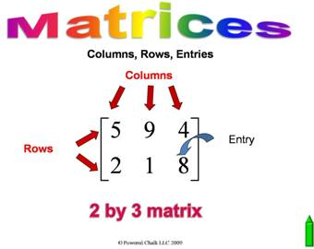
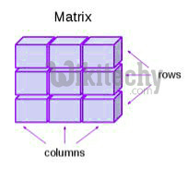

Slide 17
Matrices
Matrices are vectors with a dimension attribute. The dimension attribute is itself an integer vector of length 2 (nrow, ncol)
> m <- matrix(nrow = 2, ncol = 3)
> m
[,1] [,2] [,3] [1,] NA NA NA [2,] NA NA NA
> dim(m) [1] 2 3
> attributes(m)
$dim [1] 2 3

Slide 18
Matrices (cont’d)
Matrices are constructed column-wise, so entries can be thought of starting in the “upper left” corner and running down the columns.
> m <- matrix(1:6, nrow = 2, ncol = 3)
> m
 | [,1] | [,2] | [,3]
[1,] | 1 | 3 | 5
[2,] | 2 | 4 | 6

Slide 19
Matrices (cont’d)
Matrices can also be created directly from vectors by adding a dimension attribute.
> m <- 1:10
> m
[1] 1 2 3 4 5 6 7 8 9 10
> dim(m) <- c(2, 5)
> m
 | [,1] | [,2] | [,3] | [,4] | [,5]
[1,] | 1 | 3 | 5 | 7 | 9
[2,] | 2 | 4 | 6 | 8 | 10

Slide 20
cbind-ing and rbind-ing
Matrices can be created by column-binding or row-binding with cbind() and rbind().
> x <- 1:3
> y <- 10:12
> | cbind(x, y)
 |  | x | y
[1,] |  | 1 | 10
[2,] |  | 2 | 11
[3,] |  | 3 | 12
> rbind(x, y)
 | [,1] |  | [,2] | [,3]
x | 1 |  | 2 | 3
y | 10 |  | 11 | 12

Slide 21
Matrices (cont’d)
Matrices can have both column and row names.
m <- matrix(1:4, nrow = 2, ncol = 2)
dimnames(m) <- list(c("a", "b"), c("c", "d"))
> m
c d
a 1 3
b 2 4
Column names and row names can be set separately using the colnames() and rownames()
functions.
> colnames(m) <- c("h", "f")
> rownames(m) <- c("x", "z")
> m
h f
x 1 3
z 2 4

Slide 22
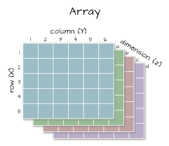

Slide 23
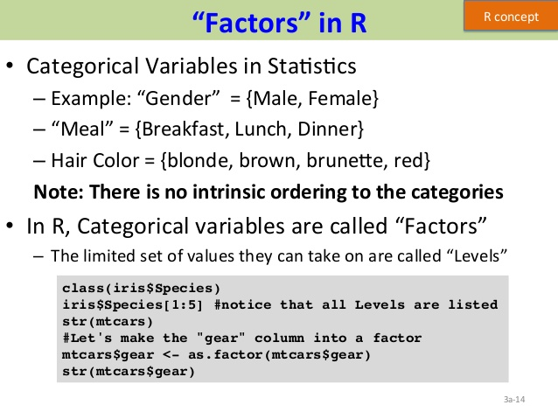

Slide 24
Factors
Factors are used to represent categorical data. Factors can be unordered or ordered. One can think of a factor as an integer vector where each integer has a label.
Factors are treated specially by modelling functions like lm() and glm()
Using factors with labels is better than using integers because factors are self-describing; having a variable that has values “Male” and “Female” is better than a variable that has values 1 and 2.

Slide 25
Factors
> x <- factor(c("yes", "yes", "no", "yes", "no"))
> x
[1] yes yes no yes no Levels: no yes
> table(x) x
no yes 2 3
> unclass(x) [1] 2 2 1 2 1
attr(,"levels")
[1] "no" "yes"

Slide 26
Factors
The order of the levels can be set using the levels argument to factor(). This can be important in linear modelling because the first level is used as the baseline level.
> x <- factor(c("yes", "yes", "no", "yes", "no"), levels = c("yes", "no"))
> x
[1] yes yes no yes no Levels: yes no

Slide 27
Lists
Lists are a special type of vector that can contain elements of different classes. Lists are a very important data type in R and you should get to know them well.
> x <- list(1, "a", TRUE, 1 + 4i)
> x [[1]]
[1] 1
[[2]]
[1] "a"
[[3]]
[1] TRUE
[[4]]
[1] 1+4i

Slide 28
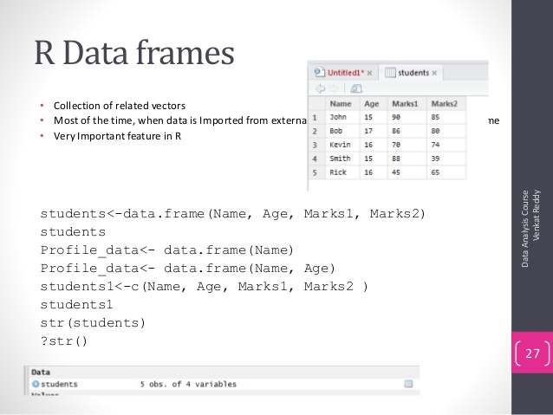

Slide 29
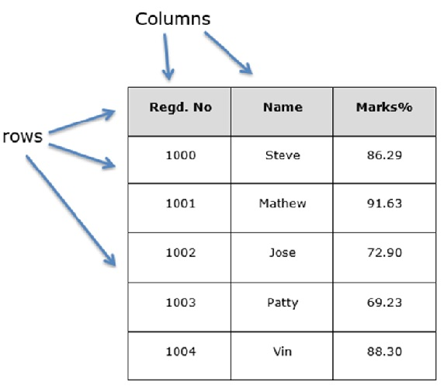

Slide 30
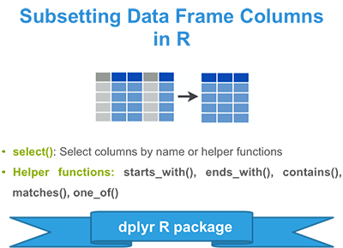
Data Frames
Store tabular data in R.
Important type of object in R
Used in a variety of statistical modeling applications.
Hadley Wickham’s package dplyr³⁵ has an optimized set of functions designed to work efficiently with data frames.
Usually created by reading in a dataset using the read.table() or read.csv().
Can be created with the data.frame() function
can be coerced from other types of objects like lists.
Data frames can be converted to a matrix by calling data.matrix().

Slide 31
Create dataframe using
data.frame() function
> x <- data.frame(foo = 1:4, bar = c(T, T, F, F))
> x
foo bar
1 1 TRUE
2 2 TRUE
3 3 FALSE
4 4 FALSE
> nrow(x)
[1] 4
> ncol(x)
[1] 2

Slide 32
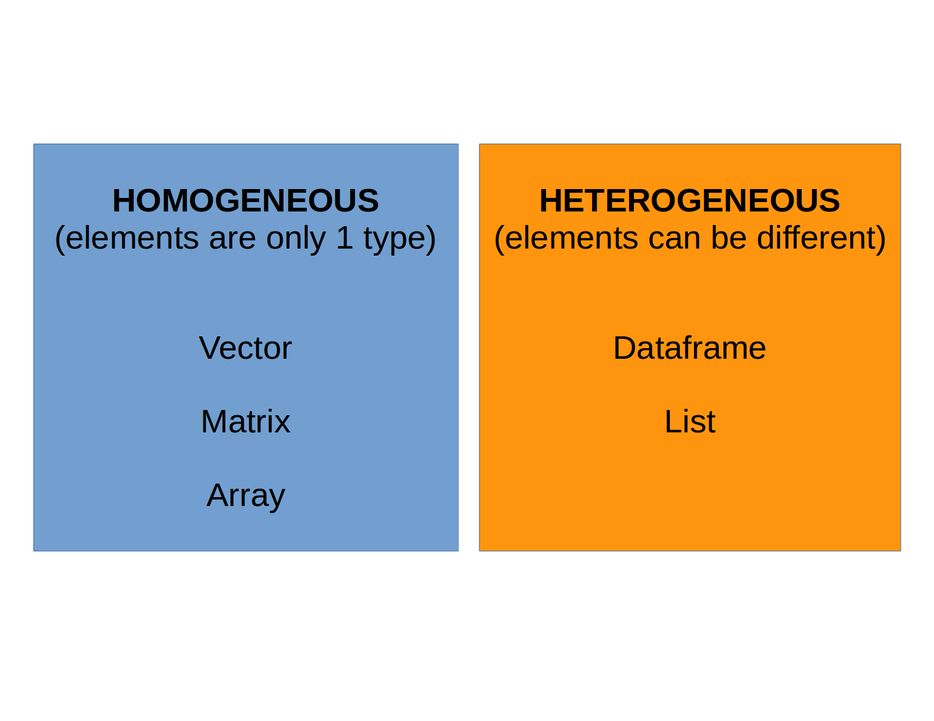
Summary of types of Objects

Slide 33
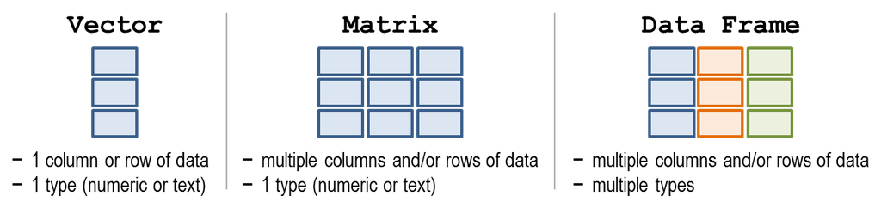
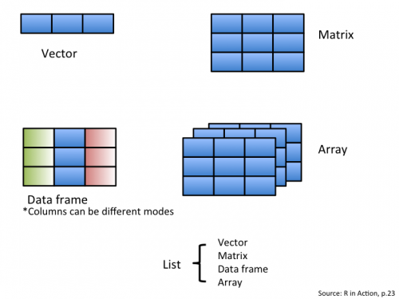
Summary of types of Objects

Slide 34
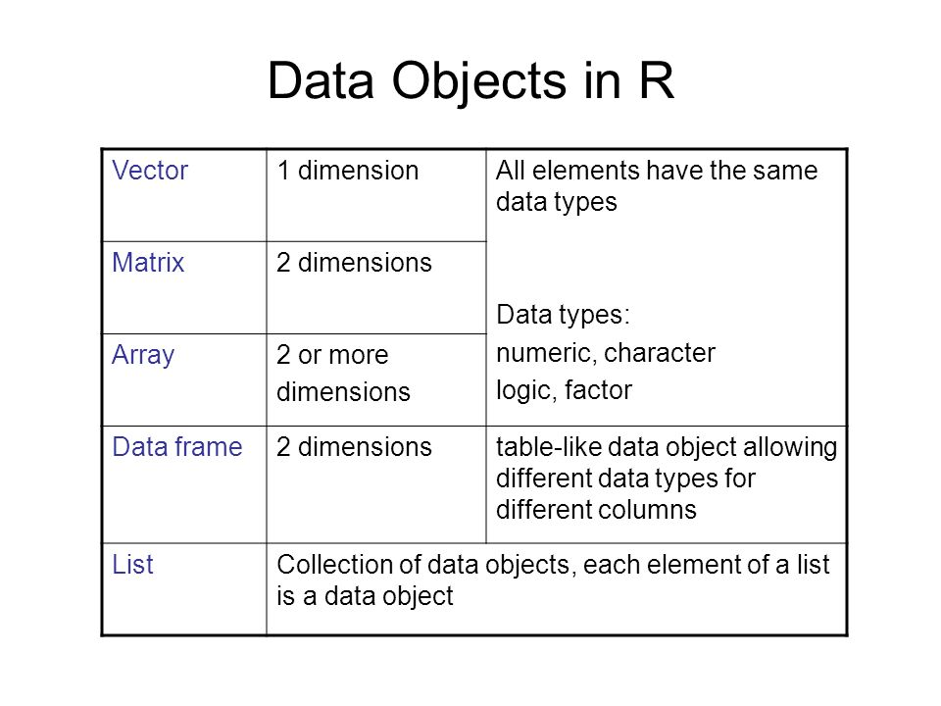
Summary of types of Objects

Slide 35
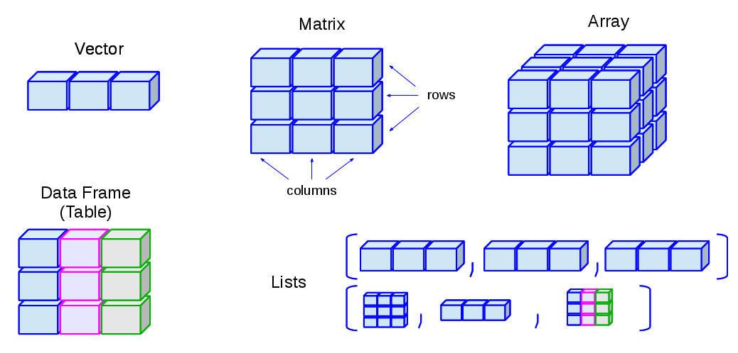
Summary of types of Objects

Slide 36
Missing Values
Missing values are denoted by NA or NaN
q is for undefined mathematical operations.
is.na() is used to test objects if they are NA
is.nan() is used to test for NaN
NA values have a class also, so there are integer NA, character NA, etc
A NaN value is also NA but the converse is not true

Slide 37
Missing Values
> ## Create a vector with NAs in it
> x <- c(1, 2, NA, 10, 3)
## Return a logical vector indicating which elements are NA
>is.na(x)
[1] FALSE FALSE TRUE FALSE FALSE
> ## Return a logical vector indicating which elements are NaN
is.nan(x)
[1] FALSE FALSE FALSE FALSE FALSE
> ## Now create a vector with both NA and NaN values
> x <- c(1, 2, NaN, NA, 4)
> is.na(x)
[1] FALSE FALSE TRUE TRUE FALSE
> is.nan(x)
[1] FALSE FALSE TRUE FALSE FALSE

Slide 38
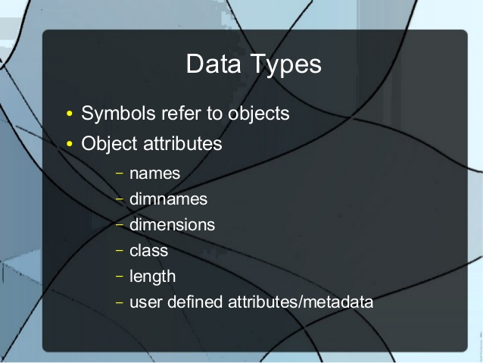

Slide 39


Slide 40
Install swirl
The swirl R package makes it fun and easy to learn R programming and data science.
Open RStudio (or just plain R if you don't have RStudio) and type the following into the console:
install.packages("swirl")
This is the only step that you will repeat every time you want to run swirl.
> library("swirl")
> swirl()
Swirl Courses Network
http://swirlstats.com/scn/title.html
swirl::install_course("R Programming")

